Slide 1
Hindi prosody through the lens of prominence theory
Jennifer Cole
Northwestern University
Funding from NSF BCS12 51343

Slide 2
The prosody (or intonation) puzzle
What is the prosodic system of Hindi/Urdu, and (how) is it different from other languages?
How does the prosodic system interface with other levels of linguistic organization?
What kinds of meaning are expressed through prosody?

Slide 4
Prosodic encoding of information structure: Accent models
Prosody & IS in Hindi/Urdu: Focus and Word order
Variability in the Prosody-IS mapping
IS encoding through Prominence relations-- it’s more than prosody
Hindi/Urdu in a prominence typology

Slide 5
Accent models
Early work on English…
Phrasal accent is assigned to the rightmost stressed word.
We saw some good MOVIES.
I bought a POODLE.
Notes:
Accented words are realized with a prominence-lending pitch movement.
The default position for accent is final in the phrase; accent shifts leftward to avoid accenting a given word.

Slide 6
Accent models
Accent marks new information; given information is unaccented.
There are MOVIES, and there are good MOVIES.
I bought a POODLE, because I’ve always wanted a DOG.
Chafe, 1976; Halliday, 1967; Bolinger 1961
Notes:
Accented words are realized with a prominence-lending pitch movement.
The default position for accent is final in the phrase; accent shifts leftward to avoid accenting a given word.

Slide 7
Accent models
Accent marks new information; given information is unaccented:
There are MOVIES, and there are GOOD movies.
I bought a POODLE, because I’ve always WANTED a dog.
Chafe, 1976; Halliday, 1967; Bolinger 1961
Notes:
Accented words are realized with a prominence-lending pitch movement.
The default position for accent is final in the phrase; accent shifts leftward to avoid accenting a given word.

Slide 8
Accent models
A later development: Accent type distinguishes focus type
H* for informational focus; L+H* for contrastive focus
Pierrehumbert & Hirschberg 1990; Ito & Speer 2008
Q: How was the story leaked?
H*
A: Terry phoned the reporter.
Q: Did Jonah leak the story?
L+H*
A: Terry phoned the reporter.

Slide 9
Accent models
Later yet…
Prenuclear accent patterns can distinguish focus breadth
Prenuclear accent is ok with broad VP focus, but not with narrow Obj focus
Selkirk 1995; Breen et al. 2010; Bishop 2017
Q: What did Robert do?
A: He [borrowed the SALT]_{FOC}
He [borrowed the SALT]_{FOC}
Q: What did Robert borrow?
A: He borrowed [the SALT]_{FOC}
*He borrowed [the SALT]_{FOC}

Slide 10
Selective vs. non-selective accenting
Prosodic encoding of IS in English (& German) depends on:
Selective assignment of pitch accent—a word in any sentence position can be unaccented.
An inventory of distinct accent types—accent type signals IS condition
What happens in a language where nearly every word is accented, and which has a single accent melody? Hindi, Spanish, other languages, too!

Slide 11
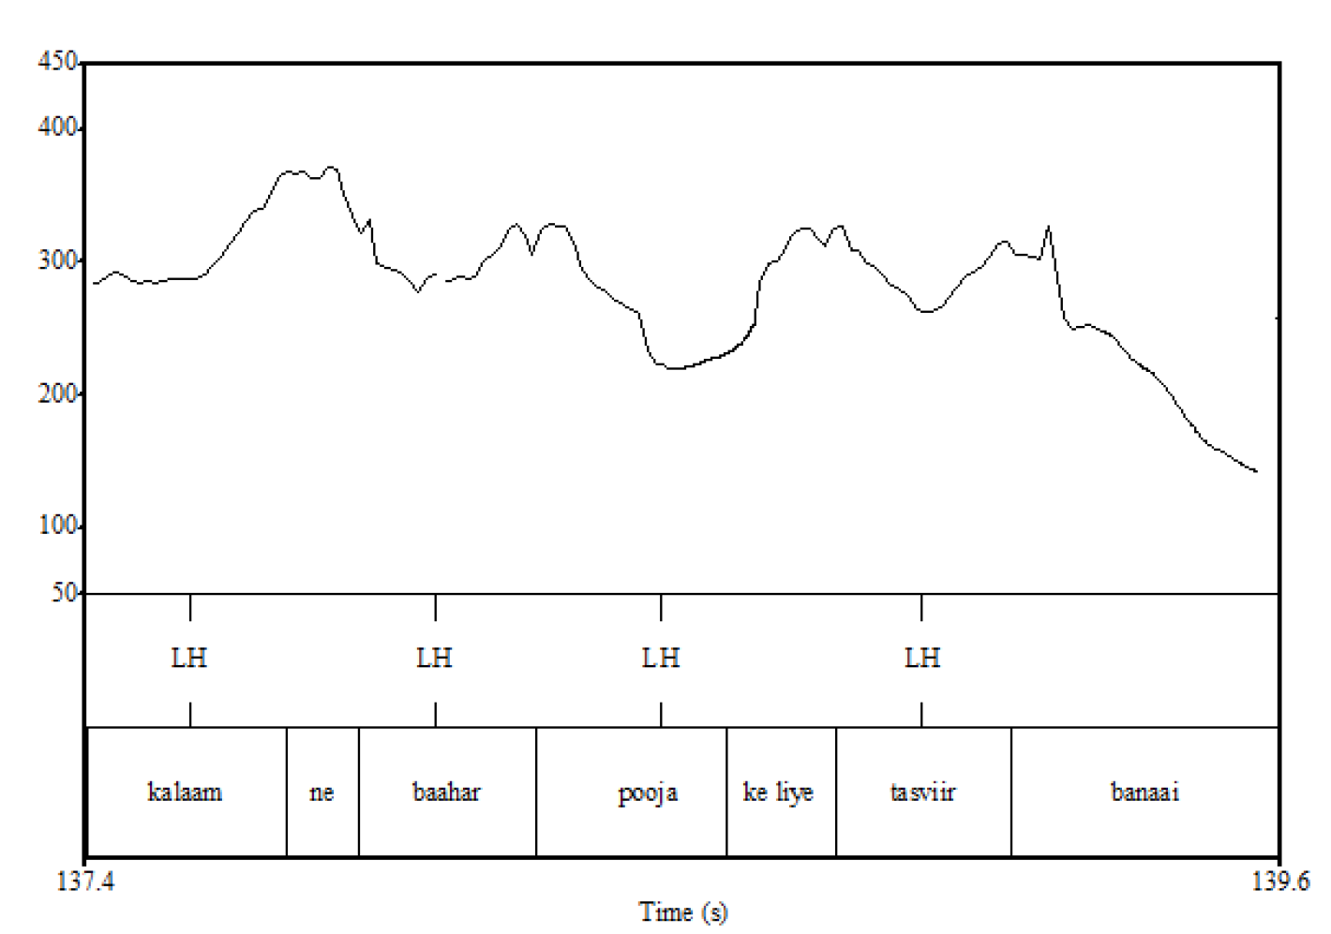
Hindi/Urdu intonation
Hindi/Urdu exhibits a fixed intonational melody (L*H-) assigned to every accentual phrase
(= every content word + following function word, in non-focused conditions)
kalaam-ne baahar Pooja ke liiye tasviir banaai
Puri (2013)

Slide 12
Eliciting IS conditions (Puri, 2013 thesis)
Question prompts determine IS condition of target word.
In this study, the target word is the Object, in pre-verbal position.
BROAD FOCUS
Q: kja: hʊa:? A: a:d̪mi: ne əpni: bi:ʋi: ke lɪje e:k səfed̪ 'sa:bʊn k^{h}əri:d̪a: | What happened? The man bought a white soap for his wife.
CORRECTIVE FOCUS
Q: […] əpni: bi:ʋi: ke lɪje e:k səfed̪ kʊrtɑ: k^{h}əri:d̪a:? A: nəhĩ […] əpni: bi:ʋi: ke lɪje e:k səfed̪ 'sa:bʊn k^{h}əri:d̪a: | Did the man buy a white shirt for his wife? No, the man bought a white SOAP for his wife.
POST-FOCUS/ GIVEN
Q: […] əpni: biʋi: ke lɪje ka:la: sa:bʊn k^{h}ərid̪a:? A: nəhĩ […] əpni bi:ʋi: ke lɪje e:k səfed̪ 'sa:bʊn k^{h}əri:d̪a: | Did the man buy a black soap for his wife? No, the man bought a WHITE soap for his wife.

Slide 13
Findings from some prior studies
Study | Tested effects of… | Main findings…
Patil, et al., 2008 | Focus type/Argument: Narrow (Subj.& Obj.) vs Broad Word order: SOV, OSV | Focused word: small effects on f0 & duration in S_{F}OV Post-focal compression and shortening No effect of focus breadth on pre-verbal constituent
Féry, Pandey, Kentner, 2016 | Focus type: (results not reported) Argument: Subject, Object Word order (speaker chosen): SOV,OSV | Focused word: small effects on f0, increase intensity in S_{F}OV; no effect on duration Post-focal compression: small effects
Genzel & Kügler, 2010 | Focus type/breadth: Broad vs Contrastive on Adj in Object NP | Focused word: effects on f0 and duration
Puri 2013 | Focus/type/breadth: Broad vs Corrective vs Given (Obj.) | Focused word: effects on f0 (focus type); intensity (focus vs. given); duration (focus type)
Jabeen, Bögel, Butt, 2016 [SpeechProsody] | Focus breadth: Contrast-Corrective vs Broad on Verb Word order: SOV, SVO | Focus: effect on f0 rise in SV_{F}O; no effect on duration Word order: different f0 effects for SOV_{F} vs SV_{F}O, for Verb and Object

Slide 14
Findings from some prior studies**
Study | Focus | Word order x Focus
Patil, et al., 2008 |  | F0, duration
Féry, Pandey, Kentner, 2016 |  | F0, intensity, (not duration)
Genzel & Kügler, 2010 | F0, duration
Puri 2013 | F0, intensity, duration
Jabeen, Bögel, Butt, 2016 [SpeechProsody] |  | F0 of verb, also pre-focus Obj. (not duration)
F0 effects, sometimes very small:
increased excursion of f0 rise on focused word
Compression of post-focal pitch range
**Statistical models vary, comparisons across studies are qualitative and only suggestive

Slide 15
Findings from some prior studies**
Study | Focus | Word order x Focus
Patil, et al., 2008 |  | F0, duration
Féry, Pandey, Kentner, 2016 |  | F0, intensity, (not duration)
Genzel & Kügler, 2010 | F0, duration
Puri 2013 | F0, intensity, duration
Jabeen, Bögel, Butt, 2016 [SpeechProsody] |  | F0 of verb, also pre-focus Obj. (not duration)
When word order and focus are tested together, effects on F0 are seen in their interaction.
Independent effects of focus on F0 are found only in studies that don’t examine word order.
**Statistical models vary, comparisons across studies are qualitative and only suggestive

Slide 16
Take-home
Word order mediates prosodic effects of Focus
… to be continued

Slide 17
Variable & vanishing effects of IS on prosody
Hindi/Urdu is not special in this regard
IS effects on prosody are hard to capture in experimental studies.
Let’s take another look at prior work (mostly on English & German)…

Slide 18
Production variability
There is a probabilistic association between IS and pitch accent in German and English,
Mücke & Grice 2014; Im, Baumann & Cole 2018
and in some cases, no association at all. Chodroff & Cole 2018
Some studies coached or exhorted speakers to produce prosodic distinctions,
Breen et al. 2010, Arvaniti & Garding 2007; Liberman & Prince 1984
and still, acoustic prosodic distinctions are often minimal, in laboratory settings. Calhoun 2012

Slide 19
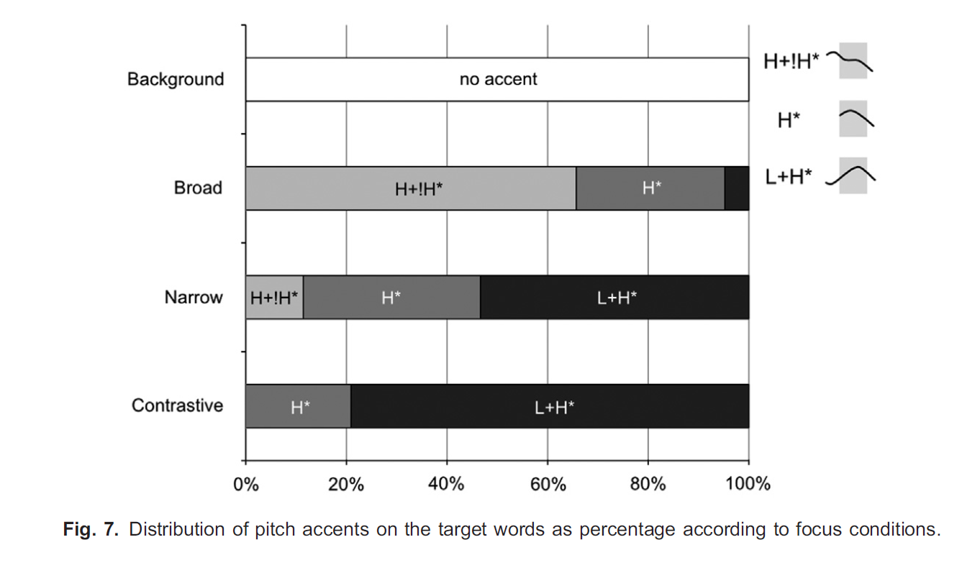
German: Distribution of nuclear pitch accents across IS categories
Mücke & Grice, 2014
Given
Broad
Narrow
Contrastive

Slide 20
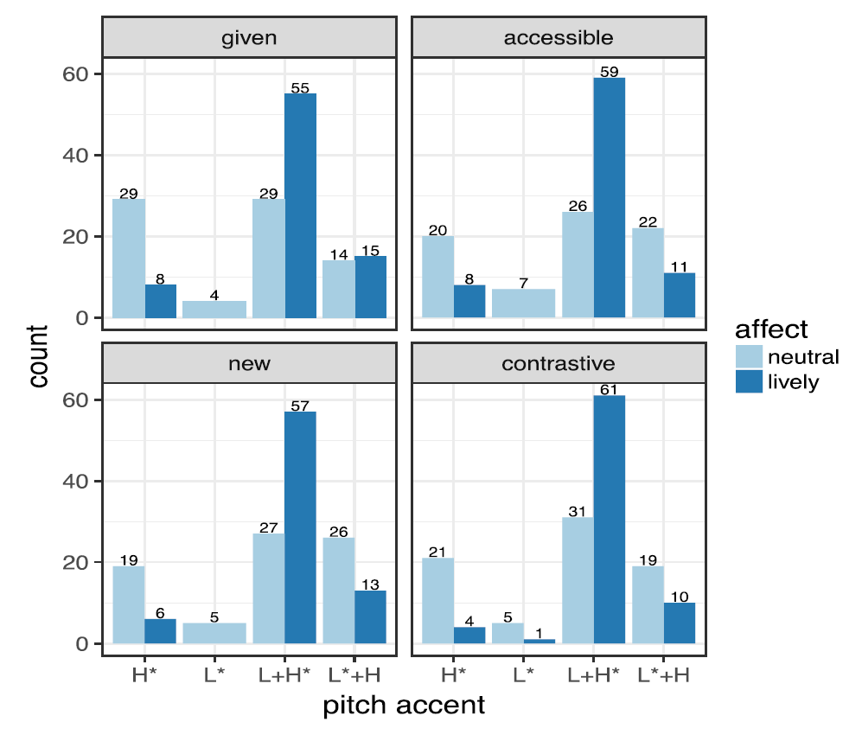
English: Distribution of prenuclear pitch accents across IS categories
Chodroff & Cole, 2018

Slide 21
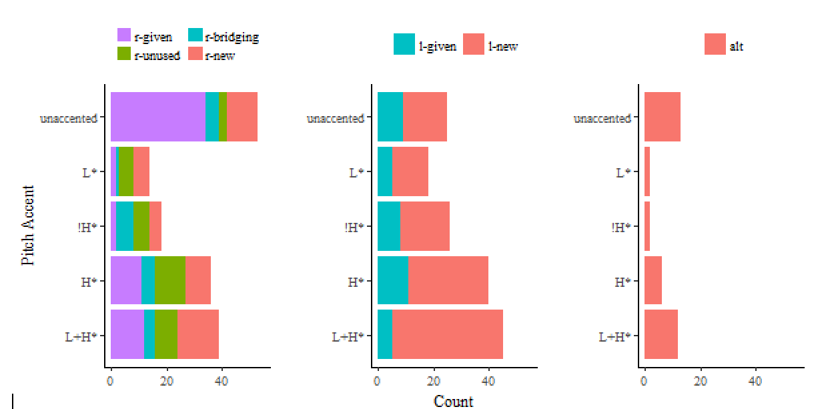
English: Distribution of pitch accents across IS categories
Im, Cole & Baumann, 2018
Referential givenness Lexical givenness Contrastive focus

Slide 22
Perceptual uncertainty
IS distinctions are not always accurately identified in metalinguistic forced-choice tasks, even with speech produced by an informed speaker. Roettger & Cole ms., Breen et al. 2010
In less explicit tasks, listeners’ behavior reveals discrimination.
Dahan et al. 2002, Ito & Speer 2008; Frauendorf et al. 2010
Discourse context may influence listener expectations, sometimes overriding acoustic cues. Listener bias may also favor recognition of common IS functions.
Bishop 2012; Breen et al. 2010; Roettger & Cole ms

Slide 23
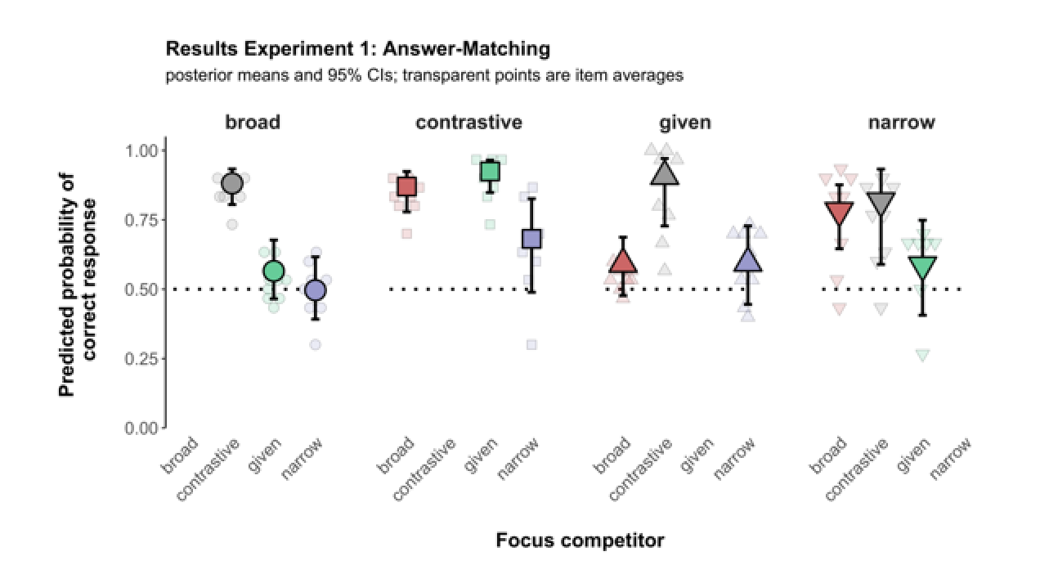
Dialogue pair from the answer-matching task
Incongruous
Q: Do you know who ripped the ledger? [Narrow focus prompt]
A: Yes, [Mary ripped the ledger]_{F}. [Broad focus prosody]
Congruous
Q: Do you know who ripped the ledger? [Narrow focus prompt]
A: Yes, [Mary] _{F} ripped the ledger. [Narrow focus prosody]
Mahrt 2018;
Roettger & Cole in prep.

Slide 24
Accuracy in choosing prosodic form to match IS condition in Q-A pairs
50% = chance
Mahrt 2018;
Roettger & Cole in prep.

Slide 25
A prominence-based account
If pitch accent type does not reliably signal the IS condition of an expression, what is the relationship between prosody and IS?
Prominence: IS distinctions are signaled by the relative prominence of words in an utterance, as reflected in:
Phonetics: pitch height & excursion, duration, intensity, phonation,…
Pitch accent type: rising > high > low
Position in sentence: final > initial
Grammatical status: subject > object > verb/predicate
Butt, Jabeen & Bögel, Linguistic Analysis. 2016

Slide 26
A prominence-based account
Beaver & Velleman (2011)
Prominence Principle: If one expression is more communicatively significant than another expression, then the first should be more surface prominent than the second.
Predictability and focus: An expression's communicative significance is based on a number of different factors. We group these factors into two broad constellations: those having to do with the predictability of the expression, and those which determine whether or not it is focused.
Competition for prominence: […] expressions within an intonational phrase will have to compete for primary accent. This competition is what determines how informationally complex material will be realized within an intonational phrase.

Slide 27
A prominence-based account
B&V’s Prominence Principle explains the prominence ranking among words in a sentence in English (and German).
Referential: A focused or surprising word must have the strongest phonetic prominence in the sentence.
Structural: peak prominence is perceived at the right edge of a prosodic phrase (=clause)
IS: New > Accessible > Given (cf., Theme > Rheme).

Slide 28
A prominence-based account
Calhoun (2006, 2012)
Metrical structure: Theme (topic, background) and Rheme (comment, foreground) are in a (metrical) weak-strong relationship. The theme must be less prominent than the rheme.
Prosodic phrase structure: In English, the rightmost prominence is perceived as the strongest, as the structural head of the phrase, so in sentences with rheme-theme order, the theme must be phonetically less prominent relative to the rheme.
Information structure: Contrastive focus must have the strongest prominence

Slide 29
Evidence from prominence rating studies
Comparative studies of prominence ratings for conversational speech
Study 1: English, French and Spanish Cole, et al. in review
Studies 2 & 3: Hindi (and Russian) Jyothi et al. 2014; Luchkina et al 2015
Preview: Prominence is perceived in relation to acoustic cues, but also in relation to structural and informational properties of words.

Slide 30
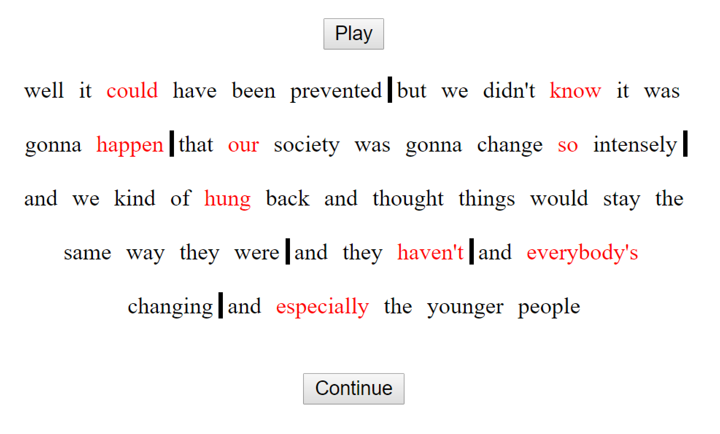
Rapid Prosody Transcription
Screenshot of web interface for prosodic annotation.
Annotator selects a word perceived as prominent (red), and/or a following boundary (vertical bar).
Rating is simultaneous with audio presentation. No pitch track or other acoustic display.

Slide 31
Study 1: English, French & Spanish
Annotators rate prominence in three conditions:
Auditory, acoustic criteria
Auditory, communicative criteria
Silent, non-specific criteria
Individual annotator ratings of prominence and boundary are analyzed for each content word in each corpus (avg. 370 words)
Regression models of prominence ratings as predicted from word-level cues, Language and Rating condition

Slide 32
English:
Agreement is similar for prominence ratings based on explicit acoustic criteria and those defined in terms of communicative importance.

Slide 33
Spanish and French: Agreement is higher for communicative prominence ratings.

Slide 34
Similar effects of acoustic cues on acoustic prominence ratings in all three languages.

Slide 35
Effects of other factors on acoustic prominence ratings are less similar in the three languages.

Slide 36
Where these languages differ is whether acoustic and non-acoustic factors have the same influence on acoustic and communicative prominence.
(they don’t)

Slide 37
In English, communicative prominence (IS) aligns with structural, phonological and phonetic prominence.
Differences in the effects of acoustic and non-acoustic factors on prominence ratings are SMALL (red bars)

Slide 38
In French and Spanish , communicative prominence aligns with structural prominence, but much less with phonological and phonetic prominence.
Differences in the effects of acoustic and non-acoustic factors on prominence ratings are LARGER (blue and gray bars)

Slide 39
How do Hindi (or Urdu) speakers rate prominence?
Like French, which has a similar intonation system?
OR
Like Spanish, which has similar word order flexibility?

Slide 40
The prominence model applied to Hindi
Prior studies of Hindi/Urdu prosody report effects of focus on acoustic prominence
f0 (all studies)
duration, intensity (some studies)
Are these effects perceived as prominence?
What is the influence of Word Order on prominence perception?
Hindi Studies 2 & 3: prominence ratings of spontaneous narrative speech, 592 words

Slide 41
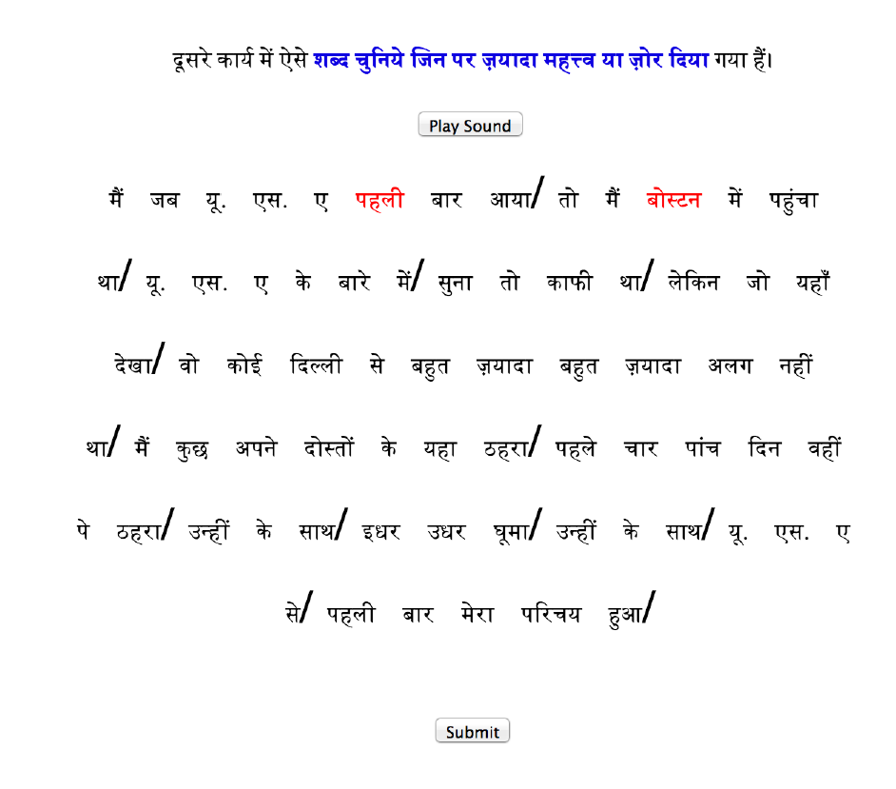
Rapid Prosody Transcription Study 2: Hindi acoustic prominence
Annotator selects a word perceived as prominent (red), and/or a following boundary (vertical bar).
Prominent words are “emphasized or stand out relative to other words in the utterance”.

Slide 42
Similar agreement on acoustic prominence ratings for all four languages.
Acoustic prominence rating is not dependent on properties of the word-level stress system.

Slide 43
Notice also agreement with ratings from the silent condition.

Slide 44
Only for Hindi: agreement is similar for prominence ratings under all conditions.
→ Lexico-syntactic prominence is highly salient.

Slide 45
Study 3: Hindi communicative / attentional prominence
Prominence rating of same speech samples used in Study 2, but with modified protocol.
Auditory presentation without text
Text presentation followed auditory presentation, and participants were instructed to mark every word that was “the focus of your attention”.

Slide 46
Hindi and English show similar agreement between acoustic and communicative prominence ratings.

Slide 47
Study 3: Hindi communicative / attentional prominence
Linear regression modeled variation in average prominence ratings by
Presence of emphatic marker hii
Position: pre-verbal vs. ex-situ (2% of clauses had postposed or preposed arguments)
Lexical & Referential givenness (Baumann & Riester 2012, 2013)
Acoustic measures: intensity, f0 max & range, duration

Slide 48
Study 3: Hindi communicative / attentional prominence
Factors that significantly boosted avg. prominence:
emphatic marker hii
pre-verbal, post-posed
Referentially new words and proper nouns
intensity, f0 max (not duration)
Unexpected effect: lexically new words had lower prominence than lexically given words. Repeated lexical mention may be a strategy for emphasis.

Slide 49
Study 3: Hindi communicative / attentional prominence
Factors that significantly boosted avg. prominence:
emphatic marker hii
pre-verbal, post-posed
Ref.-new & lex.-given words, proper nouns
intensity, f0 max (not duration)
Lexico-syntactic prominence
IS prominence
Acoustic prominence

Slide 50
Study 3: Hindi communicative / attentional prominence
Factors that significantly boosted avg. prominence:
emphatic marker hii
pre-verbal, post-posed
Ref.-new & lex.-given words, proper nouns
intensity, f0 max (not duration)
In Hindi, lexical, structural, and acoustic prominence align with IS prominence, as attentional foci.
Lexico-syntactic prominence
IS prominence
Acoustic prominence

Slide 51
Summing up
Conflicting evidence for IS effects on intonation, resolved under a Prominence model.
The Prominence Principle requires alignment of communicative prominence with “surface” prominence: lexical, syntactic, phonological, phonetic
Perceptual prominence ratings support the Prominence model in Hindi, which predicts the observed interaction of word order and focus on acoustic prominence.
Evidence for prominence alignment requires richly varying and expressive speech materials -- a methodological challenge!

Slide 52
What we’re doing now…
New study comparing Hindi & Russian:
Prominence rating with longer, intact narratives
more ex-situ word order
add animacy, grammatical status to model
Luchkina, Rimzhim, Puri & Cole
Study examining how speaker affect competes with linguistic prominence for prosodic expression in American English. Im, Cole & Baumann Speech Prosody 2018

