Slide 1
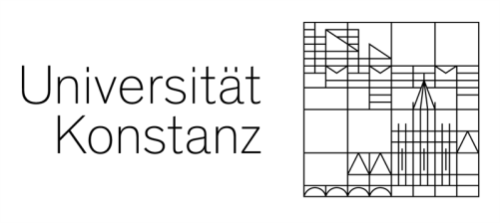
P4: Information Structure and Questions in Urdu/Hindi
Lexical Stress in Urdu
Benazir Mumtaz, Tina Bögel, Miriam Butt
University of Konstanz InterSpeech, 2020
QUESTIONS AT THE INTERFACES FOR2111
INTERSPEECH 2020
1

Slide 2
Context
Part of 2 projects: ‘Questions at the Interfaces’ funded by DFG & DAAD-Pakistan cooperation
Overall goal DAAD-Pakistan cooperation: build a Text-to-Speech (TTS) System for Urdu
Need annotated data to understand and learn prosodic patterns, so:
Conducted experiments
Recorded and annotated an Urdu Speech corpus
Many open questions remain with regard to Urdu intonation
Two major issues are:
Lexical stress: whether the basic LH is an L*H or not.
Phrasing issue: whether the unit of phrasing is a Prosodic Word or Phonological Phrase
This talk: concentrate on the issue of lexical stress in Urdu/Hindi
INTERSPEECH 2020
2

Slide 3
Structure of Talk
Some background on intonation & lexical stress in Urdu/Hindi
Two production experiments investigating the acoustic correlates of lexical stress
One experiment testing stress perception
INTERSPEECH 2020
3

Slide 4
Background: Urdu/Hindi Intonation
Basic prosodic structure of an Urdu/Hindi clause is a series of LH contours (Harnsberger 1994, Patil 2008, Féry 2010, Urooj et al. 2019 ).
The precise nature and distribution of the LH contours remains the subject of debate.
Harnsberger (1994) lists three possibilities for the realization of the basic LH
a bitonal pitch accent
an L* pitch accent followed by an H boundary tone
an LH accentual phrase
In contrast, Féry (2010) offers a new class in the typological space of intonational systems: “phrase languages”:
Phrase languages are characterized by a phrasal accent rather than pitch accents or lexical stress.
In South Asian languages, this phrasal accent is L_{p}H_{p}.
The association of the L and the H with syllables may vary.
INTERSPEECH 2020
4

Slide 5
Background: Lexical Stress
The literature on lexical stress in Urdu/Hindi is divided.
Pro:
Kelkar (1968), Pandey (1989), Hussain (2005) claim that Urdu/Hindi has lexical stress.
For them, syllable weight plays an important role in stress assignment.
This can be determined by mora count:
Long vowels are bimoraic
Short vowels and coda consonants are monomoraic.
Contra:
Féry (2010): native speakers have inconsistent intuitions about lexical stress.
Ohala (1986): there is no significant difference in the duration of stressed and unstressed vowels in Urdu/Hindi.
But: Nair (2001) notes that the stressed and unstressed syllables chosen in Ohala’s experiment were not fully matched for their segmental structure.
INTERSPEECH 2020
5

Slide 6
investigating the acoustic correlates of lexical stress Using matched segments
Experiment I: Production
INTERSPEECH 2020
6

Slide 7
Experiment 1: Matched Segments
Materials
8 pairs of words with identical segmental material in the target syllable and the onset of the following syllable
Procedure
Participants produced the target words in two settings: 1) in isolation; 2) in the carrier sentence in (1). (1) is lafz=ka matlab ————— hoga. This word=Gen meaning ————— will This word will mean —————
Stressed | Unstressed
ˈmə.ri ‘died’ | mə.ˈriz ‘patient’
ˈlo.ha ‘iron’ | lo.ˈhar ‘ blacksmith’
ˈəd̪.rək ‘gingerˈ | əd̪.ˈrɑ:k ‘awareness’
ˈmə.t̪i ‘obedient’ | mə.ˈt̪in ‘soft spoken’
ˈmən.ʃɑ ‘aim’ | mən.ˈʃur ‘manifesto’
lɑ.ˈgɑ.t̪ɑ ‘to add’ | lɑ.gɑ.ˈt̪ɑr ‘continuously’
mə.ˈzɑ.lɪm ‘cruelty’ | mə.zɑ.ˈmin ‘subjects’
ˈxə.t̪ə.rɑ ‘danger’ | xə.t̪ə.ˈrɑt̪ ‘dangers’
INTERSPEECH 2020
7
Notes:
The target syllable is stressed in the first member of a pair, and unstressed in the second member

Slide 8
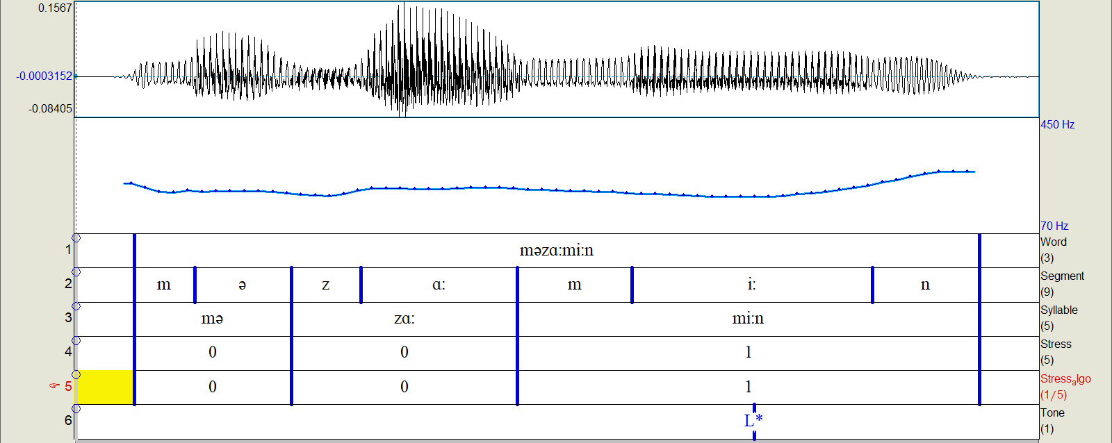
Experiment 1: Matched Segments
Participants
Ten Pakistani Urdu speakers (average age = 22.3 years, SD = 2.40 years, 6 female)
Data treatment
480 productions (2 contexts x 16 words x 10 speakers:
5 recorded the target words twice and 5 only once)
Data annotated at segment, word, syllable, stress and tone levels
INTERSPEECH 2020
8

Slide 9
Experiment 1 Results: Syllable Duration
lmer models
stress pattern as fixed factor (±stress)
participants and syllables as crossed random factors
The results support the existence of lexical stress in Urdu.
Stressed syllables have significantly longer duration:
(β= -0.04, SE = 0.005, t = -7.09,
p < 0.001)
Our results are in line with Nair’s (2001) results for Hindi.
INTERSPEECH 2020
9

Slide 10
Experiment 1 Results: Fundamental Frequency
In Isolated Words
In Carrier Sentences
Figure 1: Pitch in isolated words. The first syllable (S1) is target. The second syllable (S2) is the stress alternate.
Figure 2: Pitch development in words with carrier sentences. S1 is the target syllable. S2 the stress alternate.
In both isolated and carrier conditions, the f0 is significantly lower in the stressed syllable.
In carrier sentences the fall in pitch is less pronounced, however, the rise to the S2 is much stronger compared to the rise in the isolated word.
We think this is due to the basic LH contour: the basic LH contour is only in evidence in words produced within the carrier sentence, but not in words spoken in isolation.
INTERSPEECH 2020
10

Slide 11
Experiment 1: Discussion
The f0 results indicate that the basic LH pattern observed consistently in the literature is an effect of phrasal intonation.
Our results illustrate an interaction between lexical stress and intonational phonology.
The misalignment or variation cited by Féry (2010) in favor of a phrasal LpHp approach may not have taken into account the complexities of the interaction between lexical stress and phrasal intonation.
Moreover, our results are consistent with the L*H analysis of the basis LH contour (Harnsberger 1994, Urooj et al. 2019).
INTERSPEECH 2020
11

Slide 12
investigating the acoustic correlates of lexical stress Using Minimal Pairs
Experiment 2: Production
INTERSPEECH 2020
12

Slide 13
Experiment 2: Minimal Pairs
Material
Participants & Data Treatment
Fourteen Pakistani Urdu speakers (average age = 20.9 years, SD = 2.33 years, 8 female) & 56 productions
Data annotated at segment, word, syllable, stress and tone levels.
Words | Context
1) ˈgə.lɑ ‘throat/Noun’ | Q: Kya aap ka kaan kharab he? (Is your ear infected?) A: Nahi, mera ˈgə.lɑ kharab he. (No, my throat is infected.)
gə.ˈlɑ ‘to cook/Verb’ | Q: Kya aap ne gosht jala dia? (Did you burn the meat?) A: Nahi, mein ne gosht gə.ˈlɑ dia. (No, I cooked the meat.)
2) ˈgʰə.ʈɑ ‘thick cloud/Noun’ | Q: Kya aasman par baadal chaye hai? (Are there clouds in the sky?) A: Nahi, aasman par ˈgʰə.ʈɑ chai hai. (No, there is a thick cloud in the sky.’)
gʰə.ˈʈɑ ‘ to reduce/verb’ | Q: Kya mein is suit ka kimat bara du? (Do I increase the price of this suit) A: Nahi, is suit ki kimat gʰə.ˈʈɑ du. (No, reduce the price of this suit.)
INTERSPEECH 2020
13

Slide 14
Experiment 2 Results: Syllable Duration
In the pairs, stress pattern happened to correlate with word category:
words with 1st syllable stress are nouns
words with 2nd syllable stress are verbs
The results showed:
an increase in duration of the 1st syllable if that syllable is stressed (β= -0.015 , SE = 0.005, t = -2.802, p < 0.05)
There is no similar increase in duration on the stressed 2nd syllable.
INTERSPEECH 2020
14

Slide 15
Experiment 2: Discussion
Hypothesized reason for the statistical effect on the1st syllables:
The 1st syllable data is not confounded by boundary lengthening effects.
Lengthening effects may be due to the placement of nouns vs. verbs.
Placement Differences in our experiment:
The verbs were never sentence/clause final.
The nouns were always placed before the verbal complex.
The nouns receive a typical LH pattern in preverbal position.
Consequently:
The unstressed 2nd syllable of the noun is the last syllable of a prosodic phrase.
It thus undergoes boundary lengthening.
These factors together lead to a lack of difference between the unstressed
2nd syllable of the nouns and the stressed 2nd syllable of the verbs.
INTERSPEECH 2020
15

Slide 16
Investigating speaker inconsistent perception of lexical stress with respect to Syllable weight & weight clash
Experiment 3: Perception
INTERSPEECH 2020
16

Slide 17
Experiment 3: Perception
Materials
We tested speaker perception of lexical stress with respect to words that exhibit a weight clash vs. ones that do not.
Procedure
Randomized target words with their syllabification presented to participants on a paper in Urdu script.
Participants read the word and circle the most prominent syllable. Participants
14 participants (average age = 27.3 years, SD =5.13 years, 7 male) born and raised in Lahore.
Words with weight clash | Words without weight clash
nɑ.ˈrɑ. zi ‘anger’ | əx.bɑ.ˈrɑt̪ ‘newspaper’
xɑ.ˈmo. ʃi ‘silence’ | ɛh.kɑ.ˈmɑt̪ ‘orders’
zə.ˈmɑ .nɑ ‘time’ | mo.zu.ˈɑt̪ ‘topics’
ˈgɑ.nɑ ‘song’ | hɑ.ˈlɑt̪ ‘condition’
ˈbe.ʈi ‘daughter’ | me.ˈd̪ɑn ‘ground’
ˈgo.rɑ ‘fair/white’ | ˈbʊ.lɑ ‘to call’
ˈmi.ʈʰɑ ‘sweet’ | ˈlə.gɑ ‘to fix’
INTERSPEECH 2020
17

Slide 18
Experiment 3: Results
Percentage of stress preference in trisyllabic words with and without weight clash
Percentage of stress preference in bisyllabic words with and without weight clash
 | 1st Syllable Stressed | 2nd Syllable Stressed | 3rd Syllable Stressed
Trisyllabic words with weight clash | 35.9% | 26.1% | 38%
Trisyllabic words without weight clash | 0 | 23.8% | 76.2%
 | 1st Syllable Stressed | 2nd Syllable Stressed
Bisyllabic words with weight clash | 48.2% | 51.8%
Bisyllabic words without weight clash | 21.4% | 78.6%
INTERSPEECH 2020
18
Notes:
Participants were not able to judge stress in weight clash words at a better than chance level. However, in situations where there was no weight clash, participants perceived the target syllable as stressed 75%

Slide 19
Experiment 3: Discussion
Lexical stress perception is not random, but is dependent on syllable weight and weight clash.
In words with weight clash each heavy syllable can lead to stress perception, causing variability in stress assignment.
Lexicalization of originally derivational words can be a further source of variation.
This concerns, for example, the following words in our stimuli:
The words ‘nɑrɑzi’ and ‘xɑmoʃi’ are derivational words.
‘nɑrɑz’ and ‘xɑmoʃ’ are adjectives, the morpheme -i make them a noun
Both words are being lexicalized with Urdu speakers not aware of the original derivational nature, perhaps causing a stress shift.
This needs to be investigated further.
INTERSPEECH 2020
19

Slide 20
Summary
Our results support the existence of lexical stress with duration being a strong indicator.
We also found that lexical stress interacts with phrasal intonation and that our results are compatible with an L*H analysis of the basic LH pattern in Urdu.
We also noticed that speakers indeed vary in their perception of stress but that this variation is related to syllable weight and weight clash.
INTERSPEECH 2020
20

Slide 21
Thank You
INTERSPEECH 2020
21

